Slide 1

Loan Prediction Analysis
For SPM BANK

Slide 2

About Us
SPM bank deals in all home loans. They have presence across all urban, semi urban and rural areas. Customer first apply for home loan after that company validates the customer eligibility for loan. Company wants to automate the loan eligibility process (real time) based on customer detail provided while filling online application form. These details are Gender, Marital Status, Education, Number of Dependents, Income, Loan Amount, Credit History and others. To automate this process, they have given a problem to identify the customers segments, those are eligible for loan amount so that they can specifically target these customers.

Slide 3
Problem Statement
Background:
This project aims to develop a machine learning model that can accurately predict whether a home loan application will be approved or rejected based on the applicant's information. The model will be trained on a large dataset of labeled home loan applications, where each application is associated with an approval status (0 for rejected and 1 for approved). The model will consider various factors such as applicant income, credit history, loan amount, and other relevant information to make predictions.
Objective:
This project aims to develop a new loan approval system that simplifies the process of determining loan status for bank employees.
Scope:
The performance of the model will be evaluated using an accuracy score, which measures the proportion of correctly classified posts out of all posts in the testing set. Focus on key data attributes to create a comprehensive and effective predictive model.

Slide 4
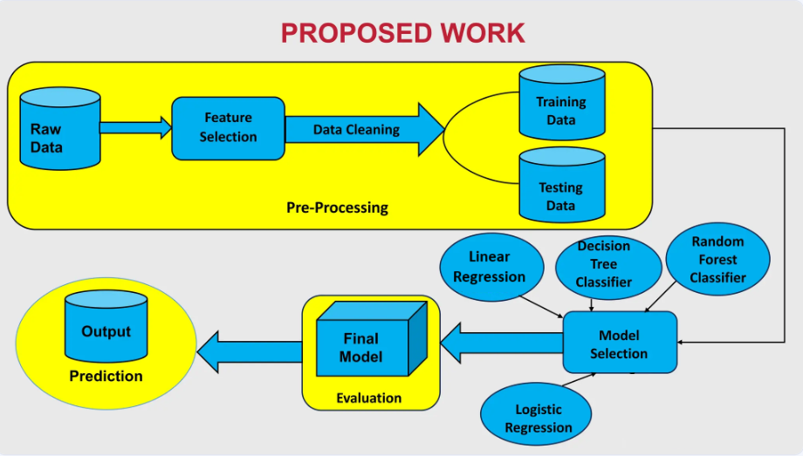
Flow-Chart For Data frame

Slide 5
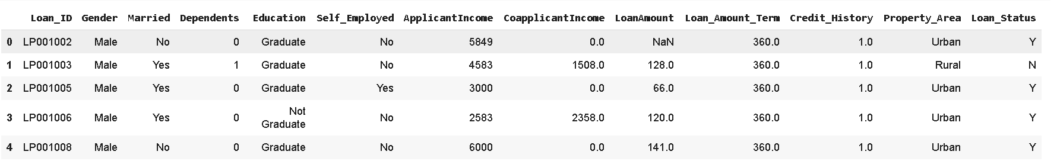
Data Frame:-
This data frame shows data for loan applications. Each row represents a different applicant, and the columns show different attributes about them, like gender, income, loan amount, and whether or not they got the loan. Based on the data, a loan is more likely to be approved when the applicant has a credit history. There also seems to be a correlation between income and loan approval.

Slide 6
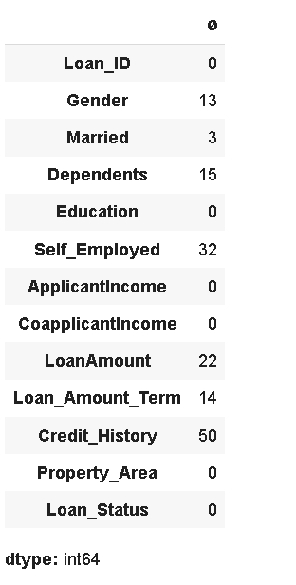
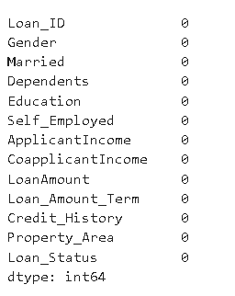
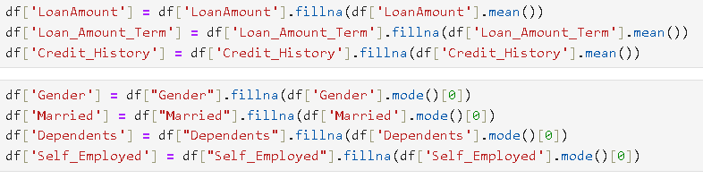
Checking Null Values and Modifying Null Values
Before Changing Null Values
After Changing Null values
The code is demonstrate the filing the null values

Slide 7
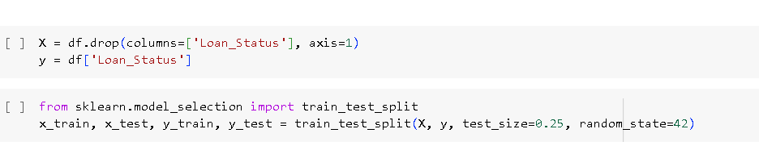
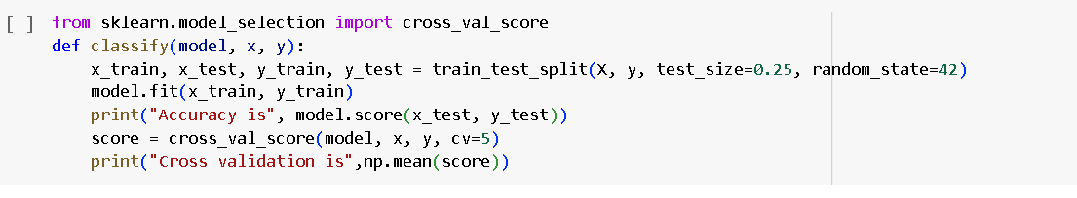
Training – Test Split

Slide 8
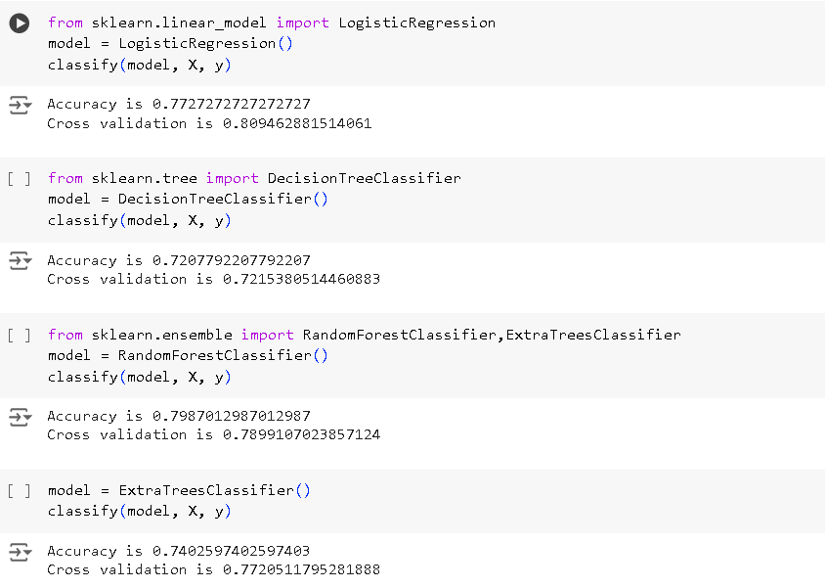
Applying Models With accuracy For Training

Slide 9
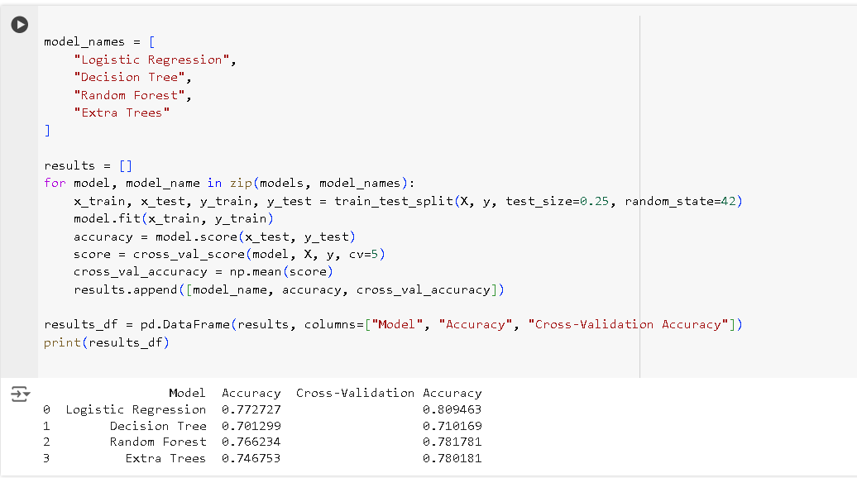
Showing The Total Accuracy for Training

Slide 10
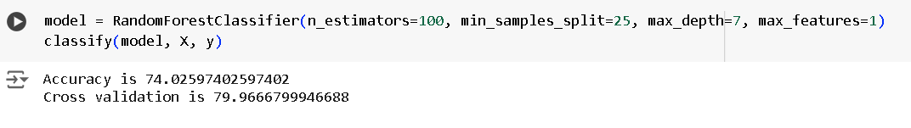
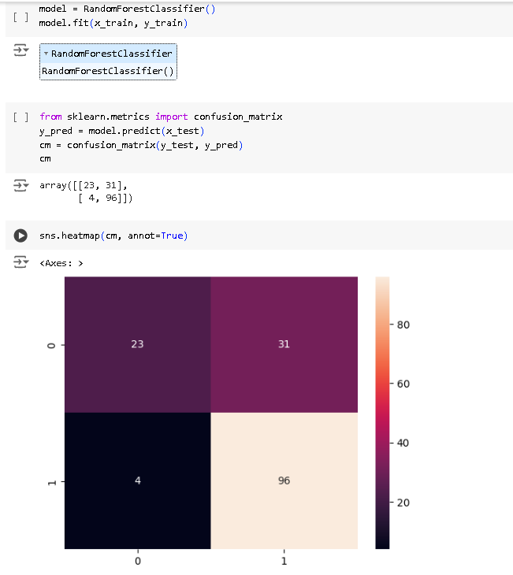
Accuracy for Testing

Slide 11

Thank You

